Slide 1
Bucktail
Council
July 2020
Text FACEBOOK to 62771 to join our community today!
Join Scout leaders across the country to share best practices and new ideas!

Slide 2
Why Do We Sell Popcorn?
73% Return to Scouting
Fund our unit’s Scouting program
Scout character development
Improve our camps and council resources
OVER $4 BILLION Returned to SCOUTING SINCE 1980!
Notes:
Council to cover

Slide 3
Agenda
Trail’s End App – Feedback, Updates, & Discussion
Trail’s End Rewards – NEW Levels in 2020!
Trail’s End Online
Trail’s End Communities – have you joined?
Product Enhancements in 2020
All the Other Sale Details
Notes:
Council

Slide 4
Trail’s End Programs
Text FACEBOOK to 62771 to join our community today!
Join Scout leaders across the country to share best practices and new ideas!
Notes:
TE

Slide 5
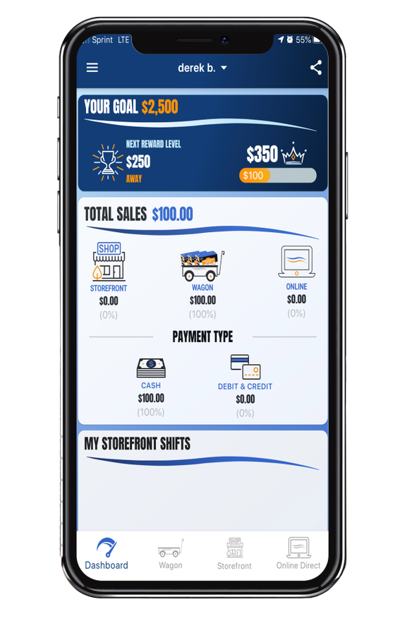
Trail’s End App
Key Benefits
Free Credit Card Processing - Paid by Trail's End
Real-time tracking and reporting of sales, inventory and storefront registrations
Families can turn in cash payments via credit card
Calculates Scout sales for easy Trail's End Rewards ordering
Take Online Direct orders in the app as way to fundraise while social distancing
SAVES TIME!
Proven Results
Used by over 14,500 units & 160,000 Scouts
Over 10% growth for units that recorded more than 75% of sales in the app in 2019​
Credit Card transactions averaged 27% higher than cash
Text APP to 62771 to download.

Slide 6
Trail’s End App
Notes:
TE

Slide 7
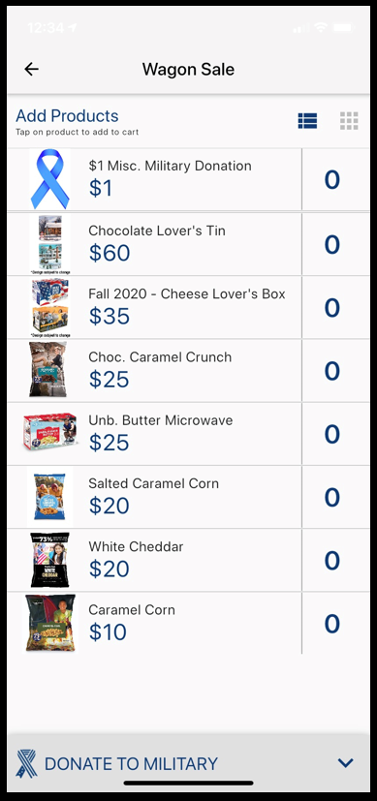
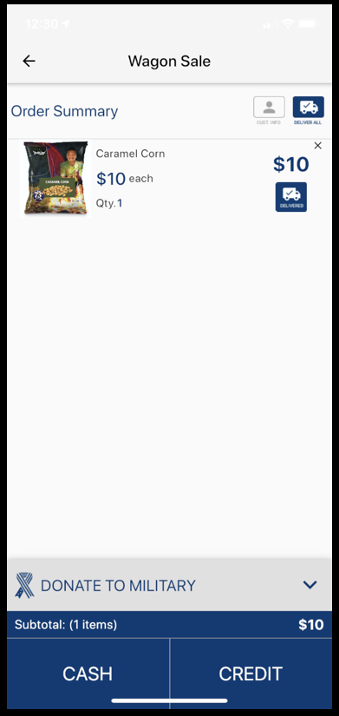
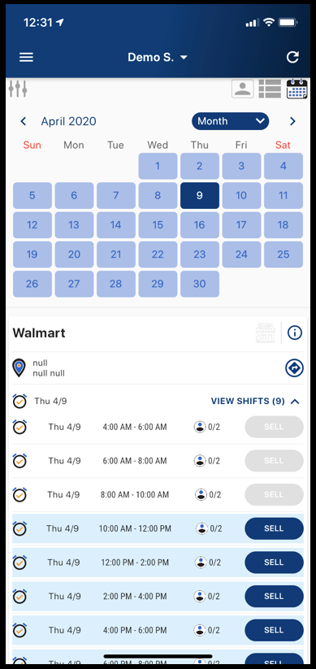
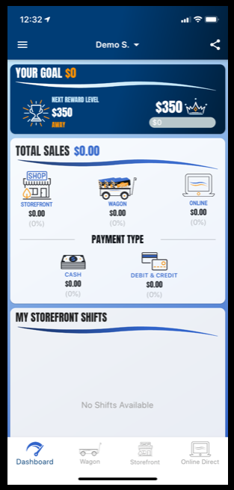
Trail’s End App
Point of Sale
Payment
Storefront Scheduling
Sale Tracking
Notes:
TE

Slide 8
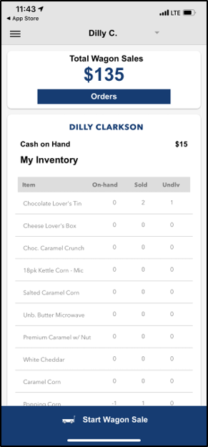
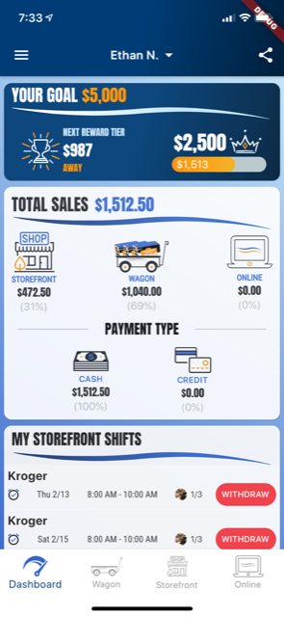
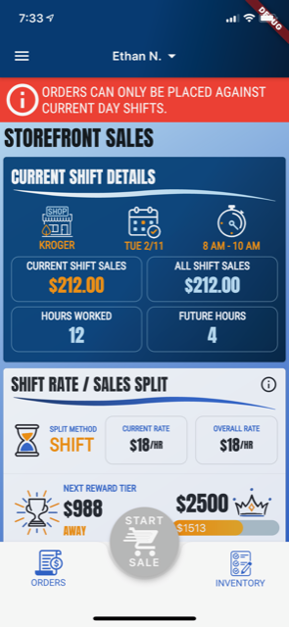
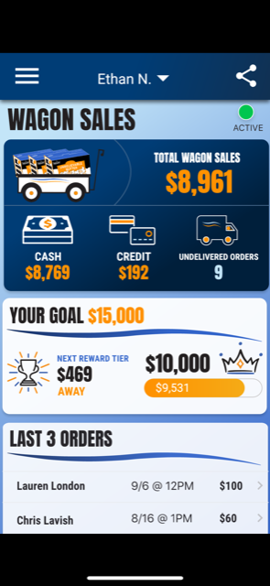
Trail’s End App
2019
2020
Notes:
TE

Slide 9
Trail’s End App Training
Over 200 Webinars in 2020
Every Question Asked…Every Question Answered!
Register at www.trails-end.com/webinars

Slide 10
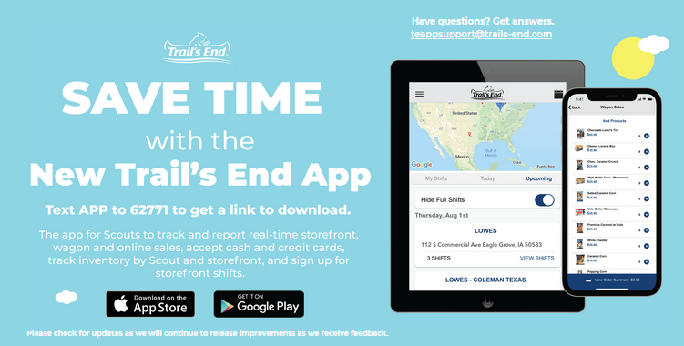
Trail’s End App Demo
Notes:
Gary to cover

Slide 11
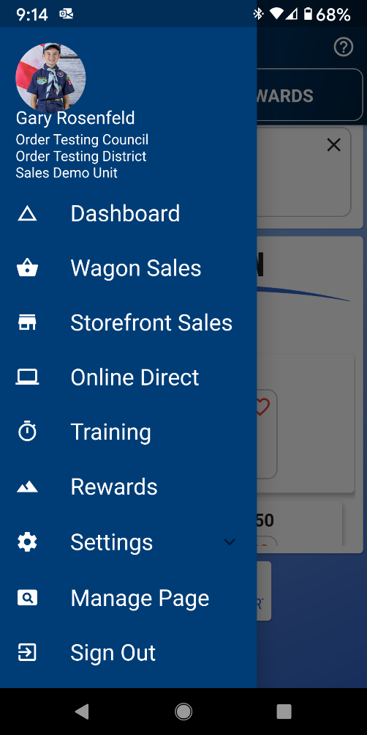
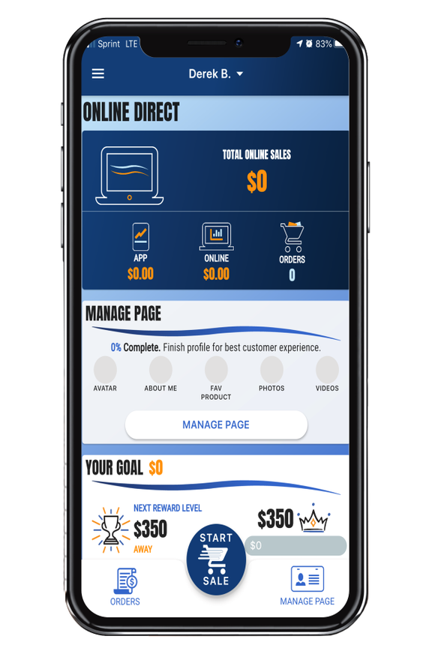
Trail’s End Online Direct
Best & Preferred Way of Selling!
BENEFITS FOR LEADERS
No handling of products, shipped direct to consumer*
No risk of excess inventory due to over ordering product up front.
No collecting cash, all orders processed with a credit card.
Less work for leaders.
Sales tracker through the app for accurate accounting.
Bonus incentive for units that sell between July 1-Aug 15
BENEFITS FOR SCOUTS
No handling of cash or products.
Scout Earn Double Points for TE Rewards
Time saver by not having to go back and deliver products.
Ease of selling through the Trail’s End app.
Share their online webpage to sell to friends and family.
Text order to customer to complete purchase on their phone
Text MYPLAN to 62771 to download: How to Sell $1,000 Social Distancing
*Consumers pay shipping for direct delivery

Slide 12
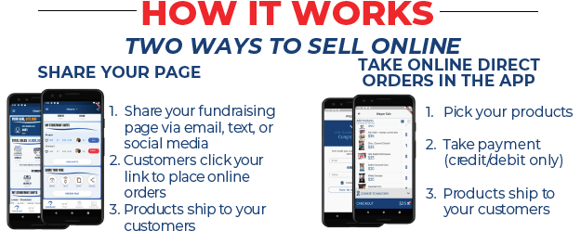
Online Direct

Slide 13
Accepting Credit/Debit
CREDIT SALES ARE BEST FOR SCOUTS
TELL YOUR CUSTOMERS, “WE PREFER CREDIT/DEBIT”
Trail’s End pays for all credit card fees!
Higher Sales – Customers spent 27% more with credit vs. cash in 2019
Safer – Scouts don’t have to handle cash
Bigger Rewards – Earn 1.5pts per $1 sold in the Trail’s End App
Easier – Parents turn in cash sales with credit/debit payments to their unit
Hardware – Scouts can accept credit/debit with Square readers or manual entry

Slide 14
Trail’s End Rewards
SCOUTS CAN SELECT FROM MILLIONS OF ITEMS WITH AN AMAZON.COM GIFT CARD
Why do Scouts love Trail’s End Rewards?
Bigger prizes and more value.
Millions of choices on Amazon.com.
Get prizes faster.
Delivered to their door.
Earn double points with Online Direct.
Scouts select what THEY want!
Why do Leaders love Trail’s End Rewards?
Saves time not have to handle and distribute physical prizes.
Leaders have reported saving on average 6 hours of time
Orders are tracked automatically for leaders when Scouts sell with the app and online.
Online direct, Storefront, and Wagon sales all count towards rewards.
Motivates Scouts to reach their goals.
Trail’s End helps train and motivate Scouts through the App features.

Slide 15
Trail’s End Rewards
New in 2020
Points based Rewards system encouraging Scouts to sell more with Online Direct and with credit cards
With changes to the way they sell, Scouts can earn more Rewards faster!

Slide 16
Start Selling Early
Reasons to Start Selling in July & August
Uncertainty of COVID-19 return
Fund your popcorn order pre-payment
Trail’s End Online Direct unit promotion:
Earn 5% of Online Direct sales as an Amazon.com gift card – Jul 1-Aug 15
Unit must be registered by August 15, 2020 to qualify.
Scout Online Direct Entrepreneur Challenge
Scouts that will pledge to do their best to sell $2,500 or more through Online Direct from July 1 – August 15 will receive exclusive access to training and webinars from experts in business, marketing, and ecommerce. The first 200 Scouts to hit the goal will receive a $200 Amazon.com Gift Card.
Notes:
TE

Slide 17
Register Your Unit
Notes:
TE

Slide 18
Facebook Communities
CREATED & MANAGED BY POPCORN KERNELS
FACEBOOK GROUPS
Over 18,000 members
5% growth for units who were on Facebook group
Scouts & Leaders get fast, accurate answers to their questions 24/7
Unit leaders and Scout parents get real-time best practices and tips from peers and Trail’s End experts
Text FACEBOOK to 62771 to join!

Slide 19
Host A Virtual Kickoff
Use Zoom (or similar software)
Agenda:
How the money raised benefits each Scout family
Unit & Scout sales goals
How to Sell $1,000 Social Distancing in 8 Hours (PDF)
Everyone downloads the Trail’s End App
Text APP to 62771 to download.
Trail’s End Rewards
Unit specific promotions (optional)
Key dates for your Sale
Request they join the Trail’s End Scout Parents Facebook Group to get tips and ask questions!
Text KICKOFF to 62771 to Download Presentation.
Notes:
TE

Slide 20
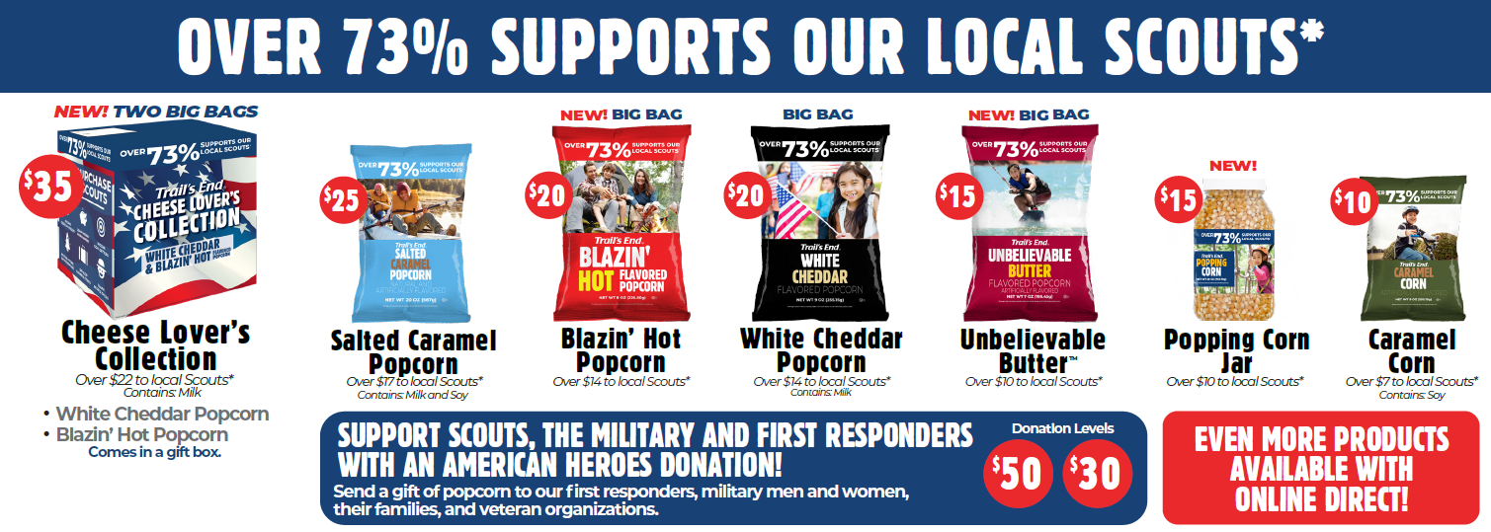
Traditional Products

Slide 21
Council Unit Commission
We are proud of the fact that our council has one of the highest commission rates in the region. It’s simple, if your unit succeeds, the programs offered will too!
Total Unit Commission
Up to 40%
of gross sales!
Base Commission:
30% of retail sales (Show N Sell, Show N Deliver and Take Order Sales)
35% of online sales

Slide 22
Council Bonus Commission
Bonus Incentive #1
Earn an extra 2.5%
Use the Trail’s End app to track sales as a unit
Encourage your Scouts to use it
Bonus Incentive #2
Earn an extra 2.5%
Pay your bill for Show’n Sell by October 9th and
Pay your final bill by November 20th
Bonus Incentive #2
Earn an extra 5%
Sell an average of $250 per registered Scout as of August 31st
Earn Up To
10%
Bonus

Slide 23
Payment Terms
Final Payment Due Date
Friday, November 20, 2020
Final payments are due to the council service center
and must be received by 4:00pm.

Slide 24
Key Dates
Show-N-Sell Popcorn Order Due | Monday, July 20 by 4:00pm
Show-N-Sell Popcorn Pick-up | Wednesday, August 5 (3:00 – 6:00pm)
Pay Show’n Sell Invoice | Friday, October 9, 2020
Take Order Popcorn Pick-up | Wednesday, November 4, 2020
Pay Final invoice | Monday, November 20, 2020

Slide 25
Returns Process
This year we will be able to accept
Only limited returns of any popcorn products.
Unit orders will be compared to last year to reduce the need for returns
Units will be able to order product as needed
We will work to match up units that may have remaining product to units that have a need for the product
We appreciate your cooperation and understanding

Slide 26
Thank You!
Questions & Answers
Remain in the meeting for questions or leave at any time when your questions have been answered.

